Slide 1


Overview of the progress of Water JPI
Enrique Playán
Former Water JPI Coordinator
EEAD-CSIC
May 19 2016
Grupo RAMA (Riego, Agronomía y medio Ambiente)

Slide 2
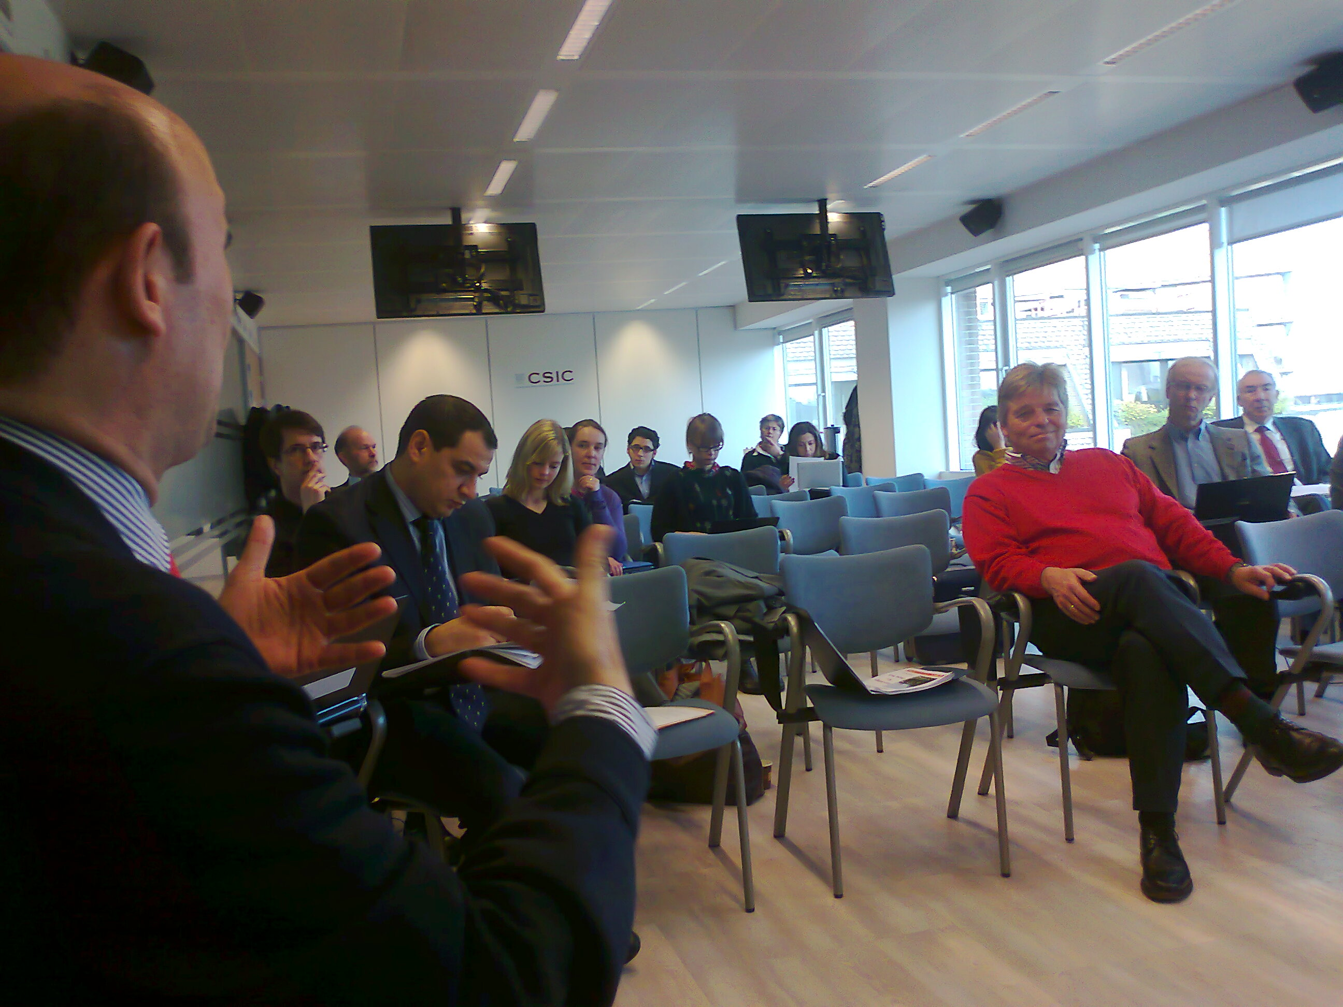
So, what is Joint Programming about?
Difficult concept
Limited expertise available
An initiative to bring resources to
Programme Owners and Managers

Slide 3
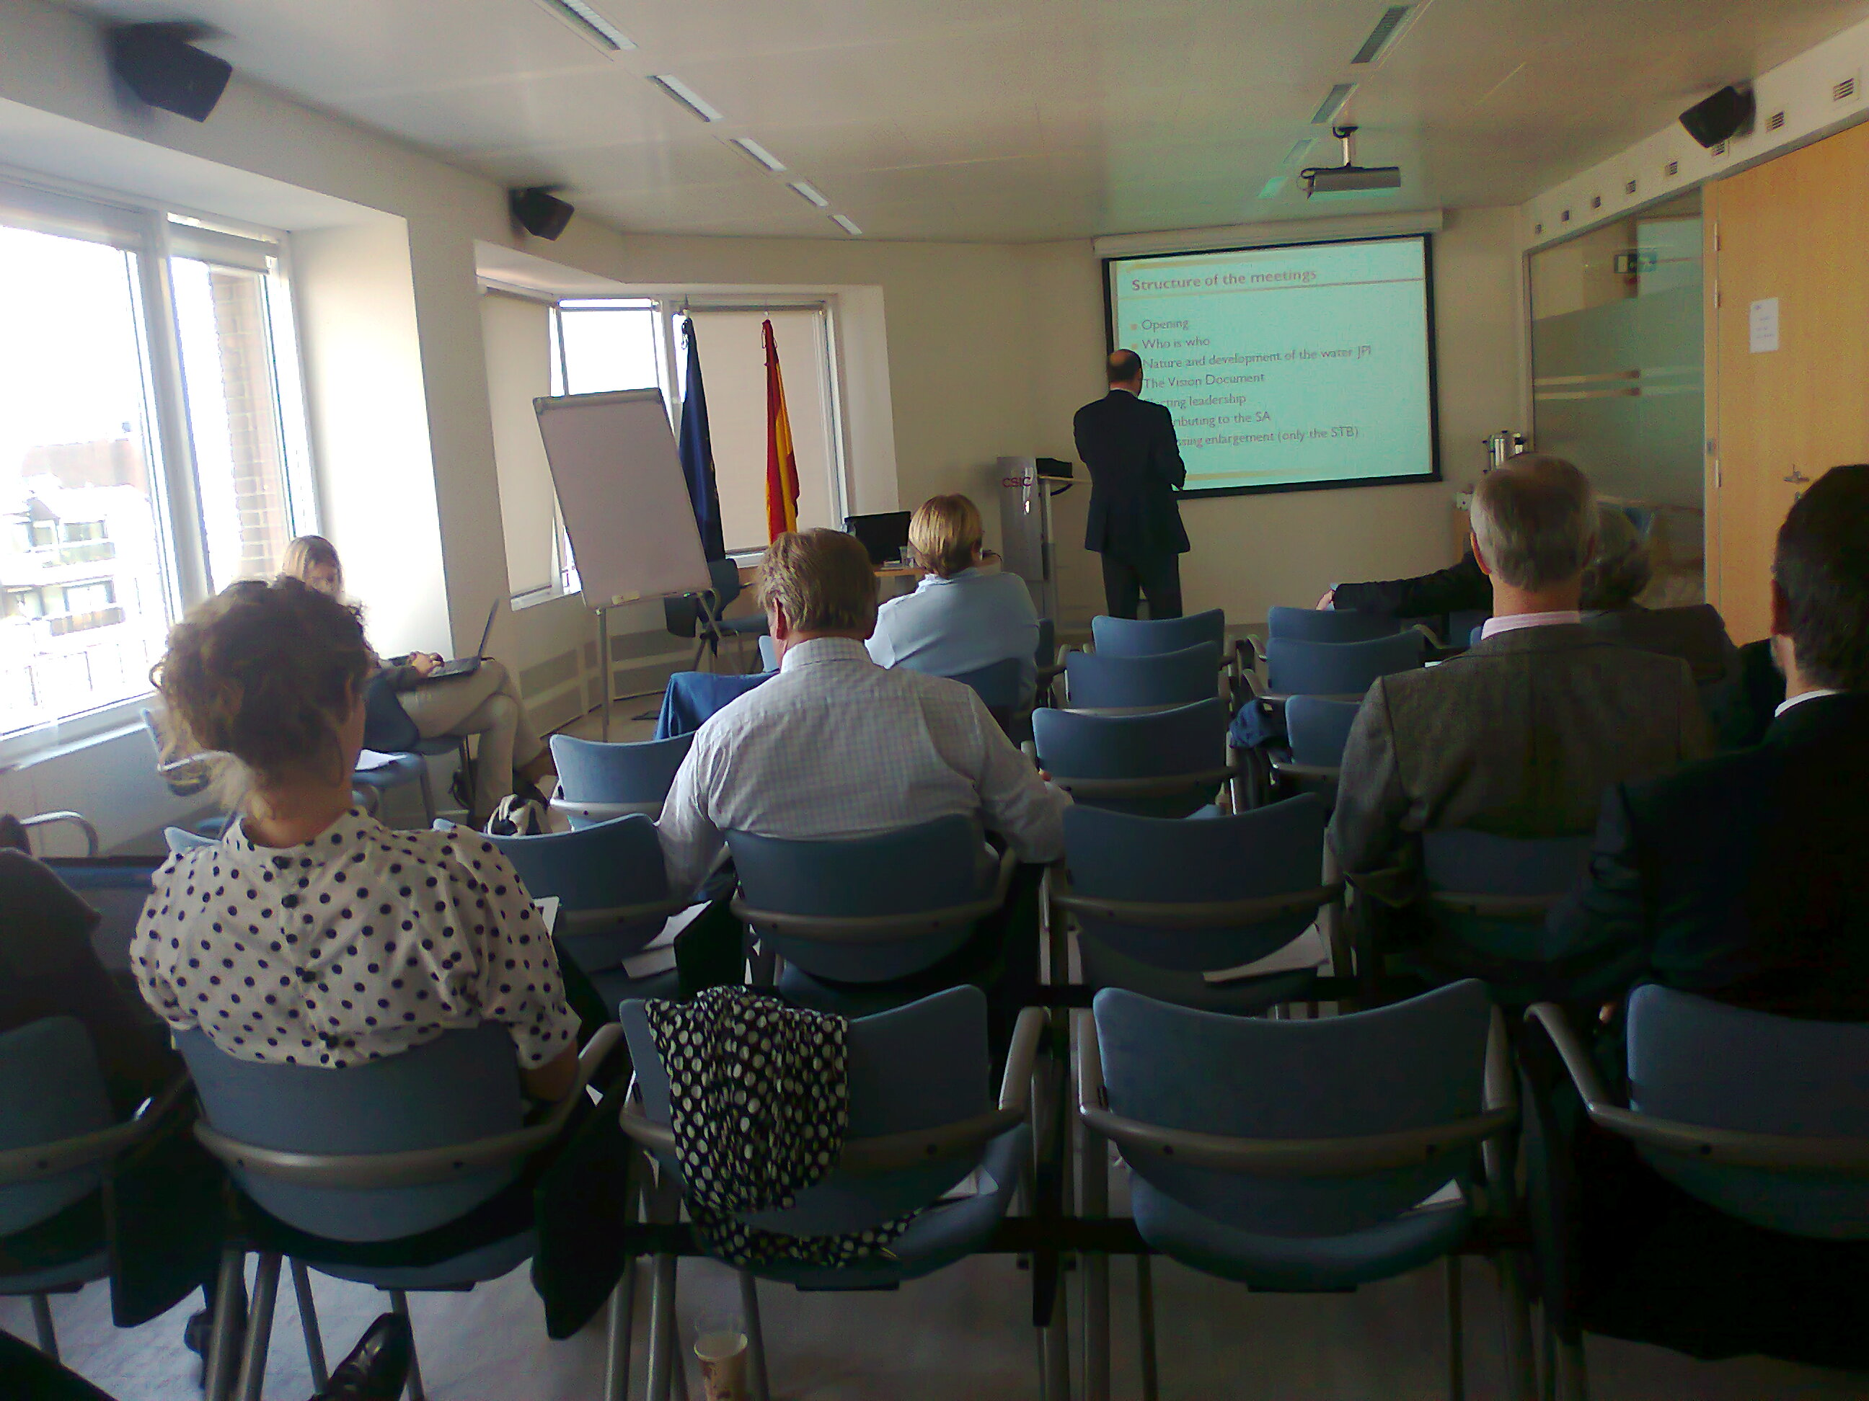
Identifying partners, establishing goals, and sustaining a dialogue with the Commission

Slide 4
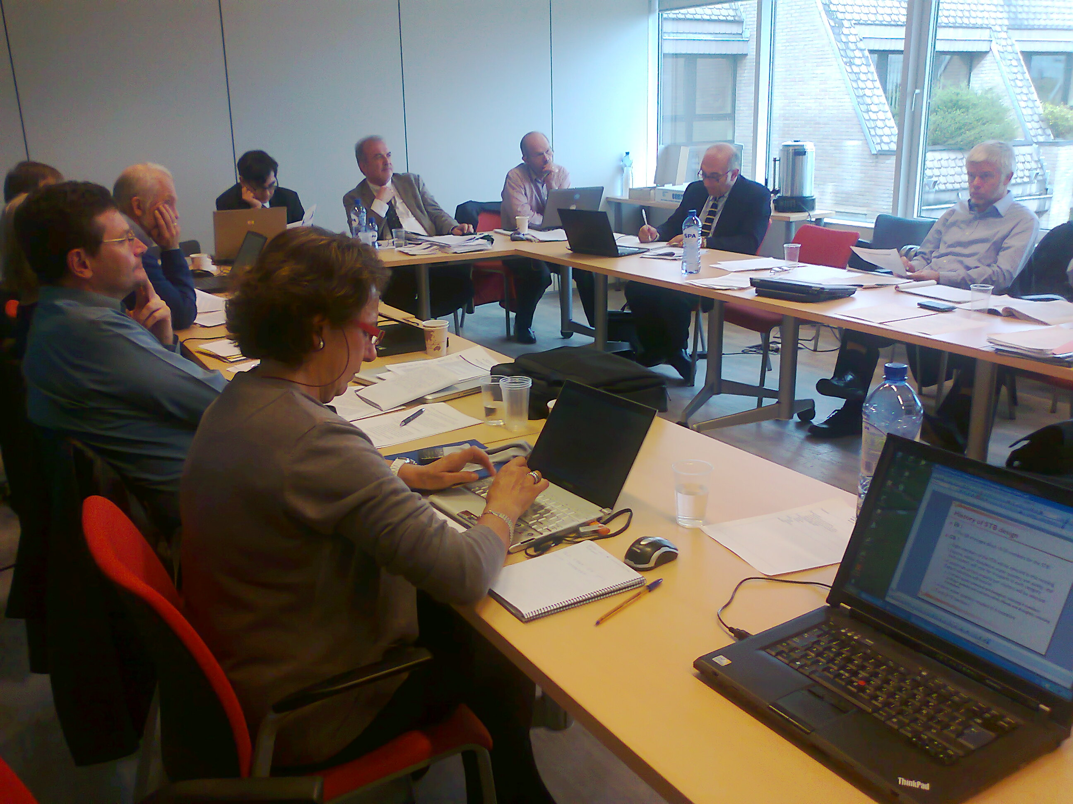
Multitasking with limited resources:
Vision, maturity report, SRIA, Proposal, Internationalization, Calls…

Slide 5
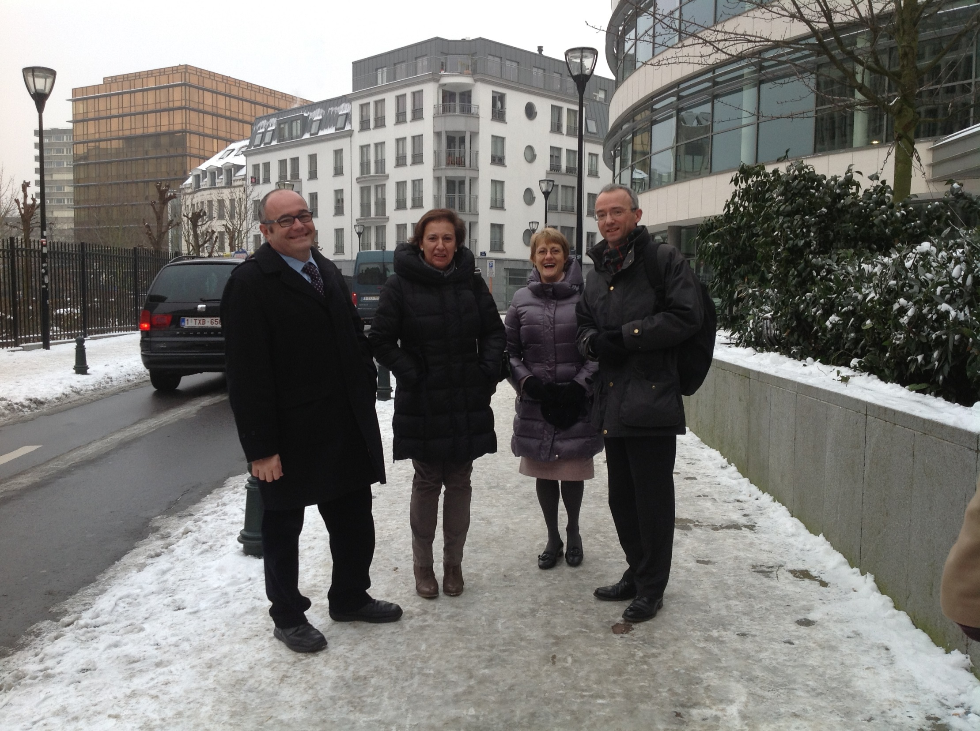
Visits to Brussels to forge alliances, reaffirm partnerships in specific issues and represent Water JPI virtually everywhere…

Slide 6
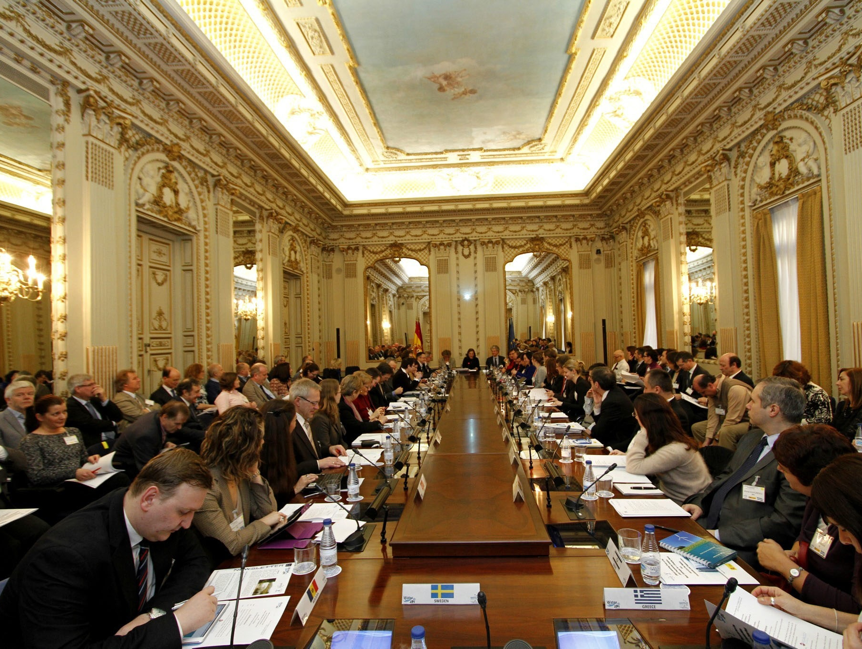
2013 marked an inflexion point:
WatEUr kick off, relevant documents ready
European visibility
Planning for funding activities

Slide 7
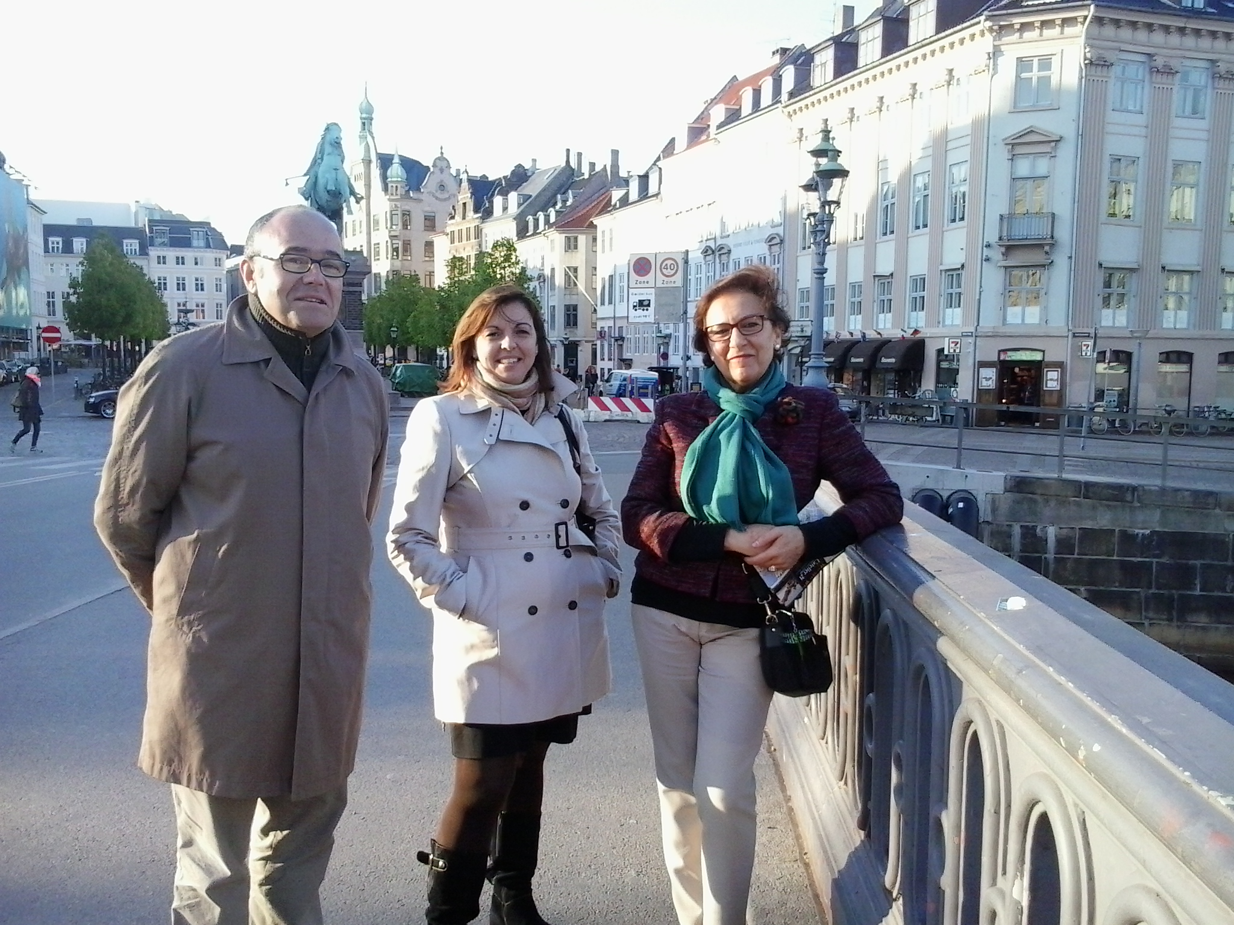
The WatEUr CSA was critical for success:
Decentralized responsibilities
Provided specific funding for Water JPI
Established a community of practice

Slide 8
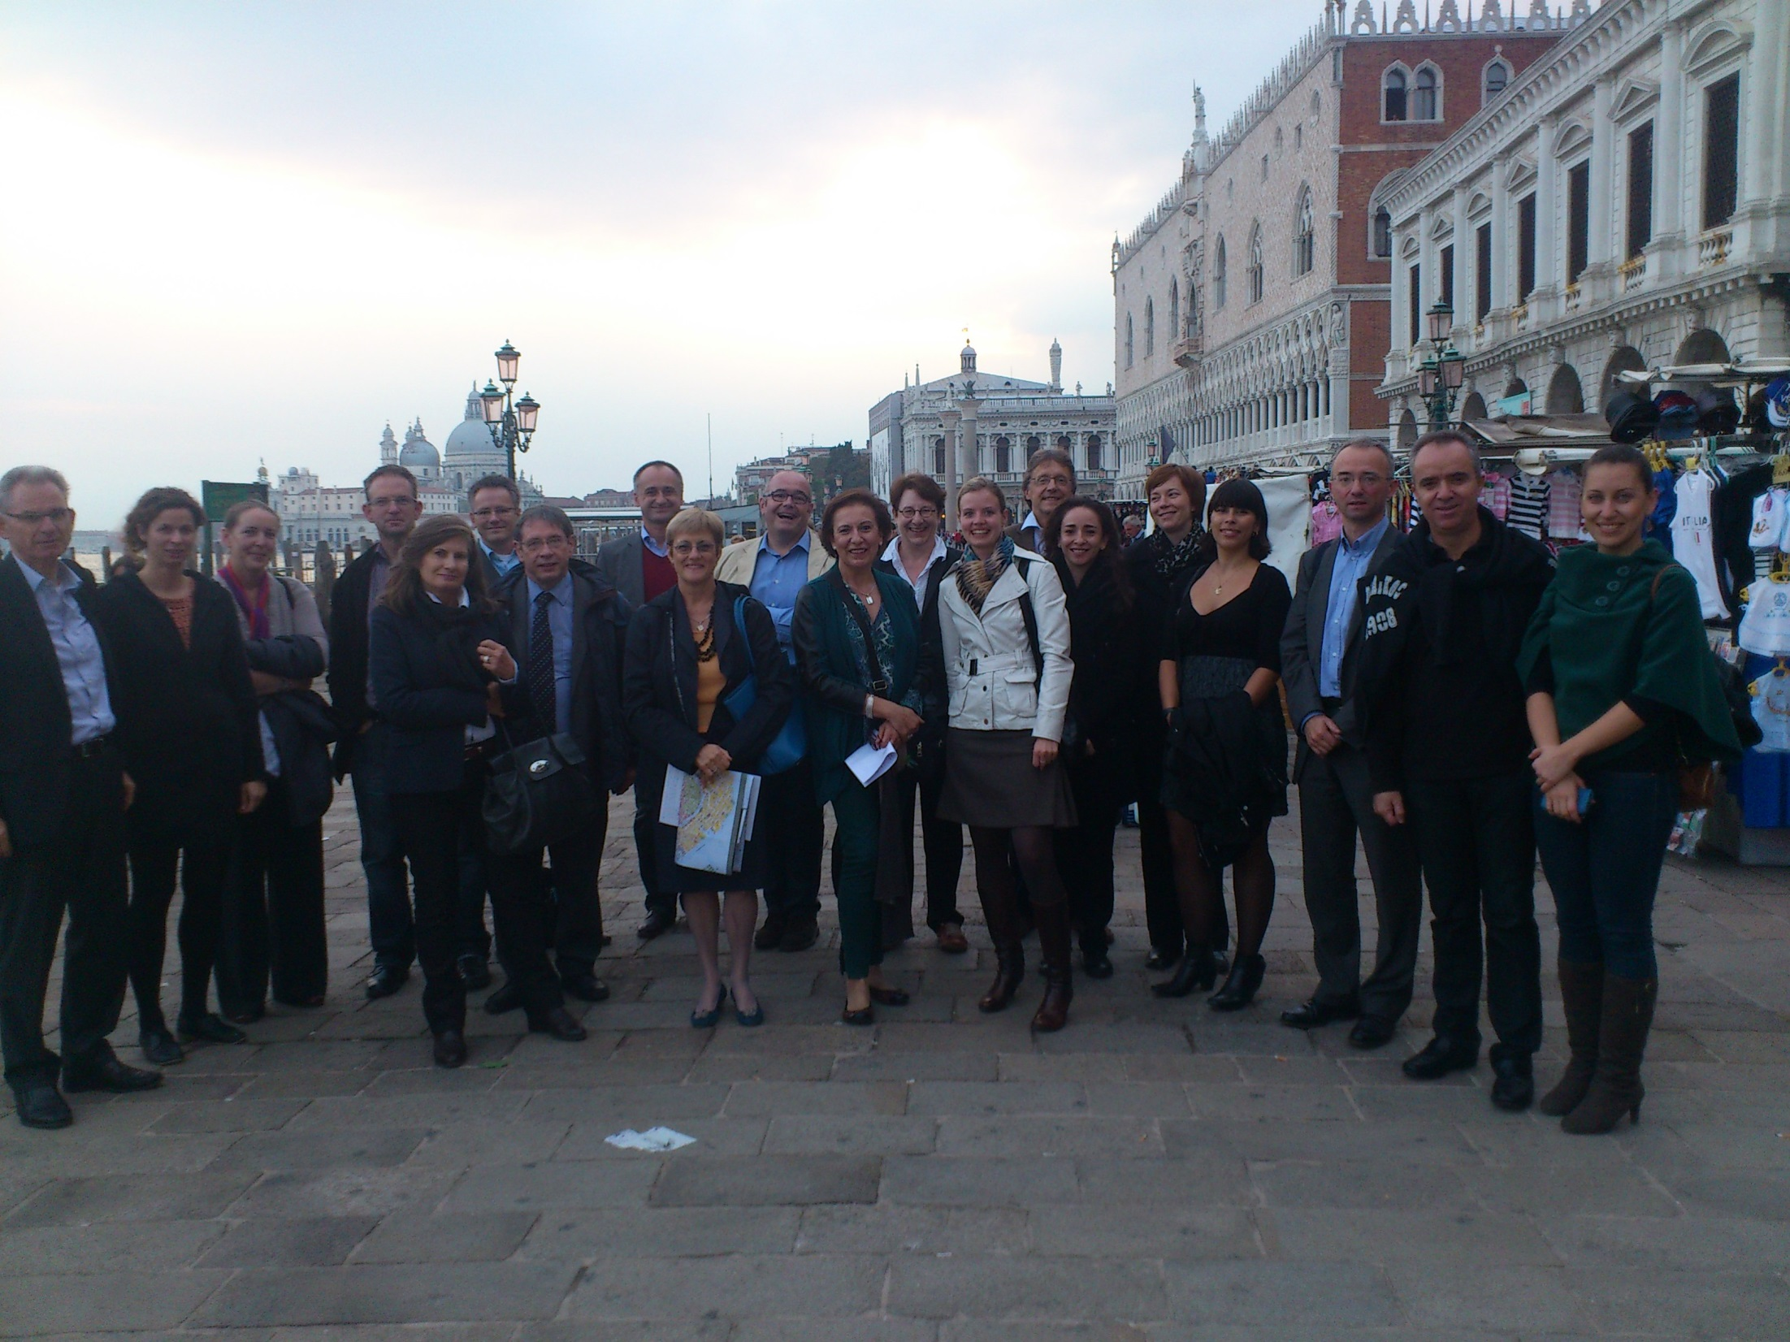
Major accomplishments:
A cohesive group of RFO’s
A map of Water RDI, a living document SRIA, internationalization, communication
Three major Calls for proposals
A smooth transition of governance
Decentralized headaches

Slide 9
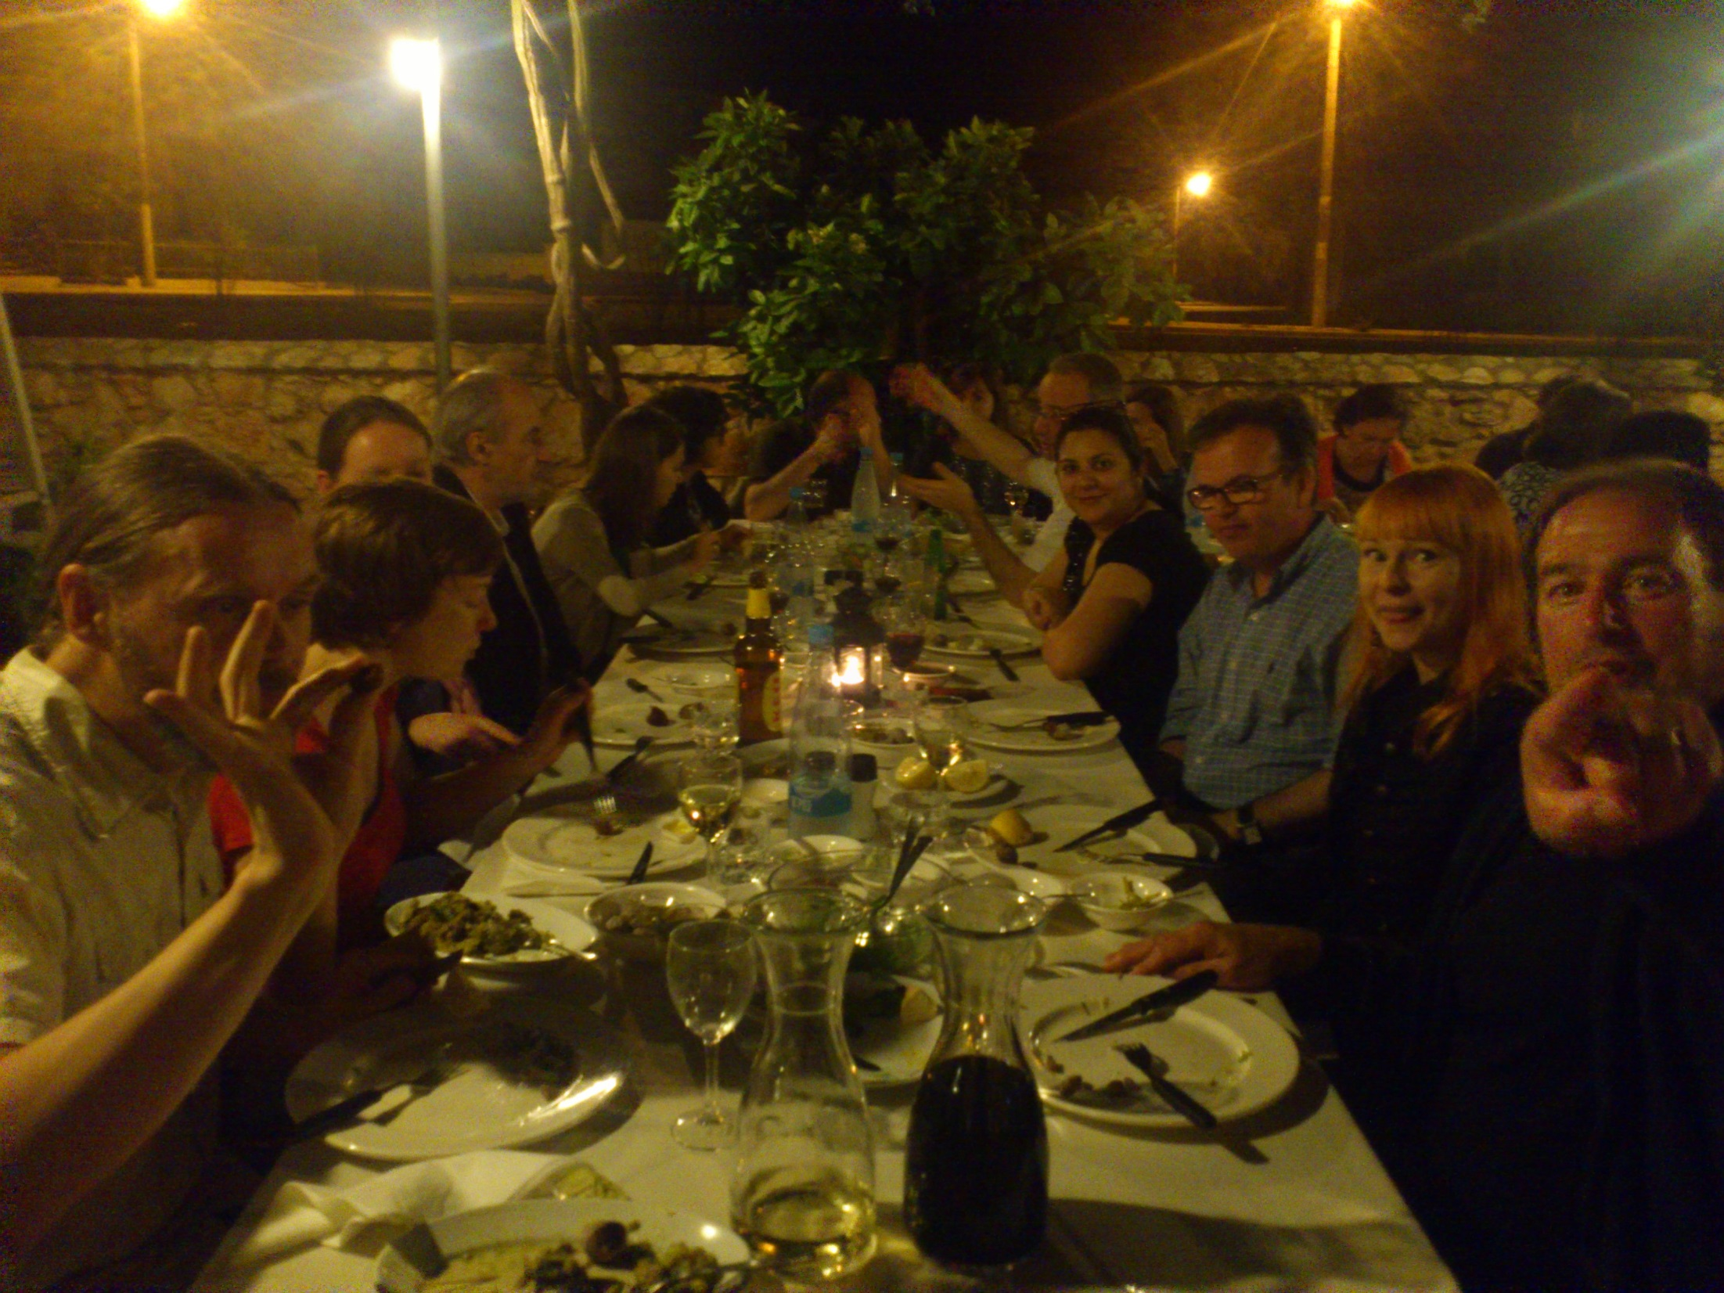
Challenges ahead:
Consolidation of efforts: importance of in-kind contributions
Attaining water JPI objectives set for 2020
The EU Framework Programme beyond Horizon 2020: Which role for JPIs?

Slide 10
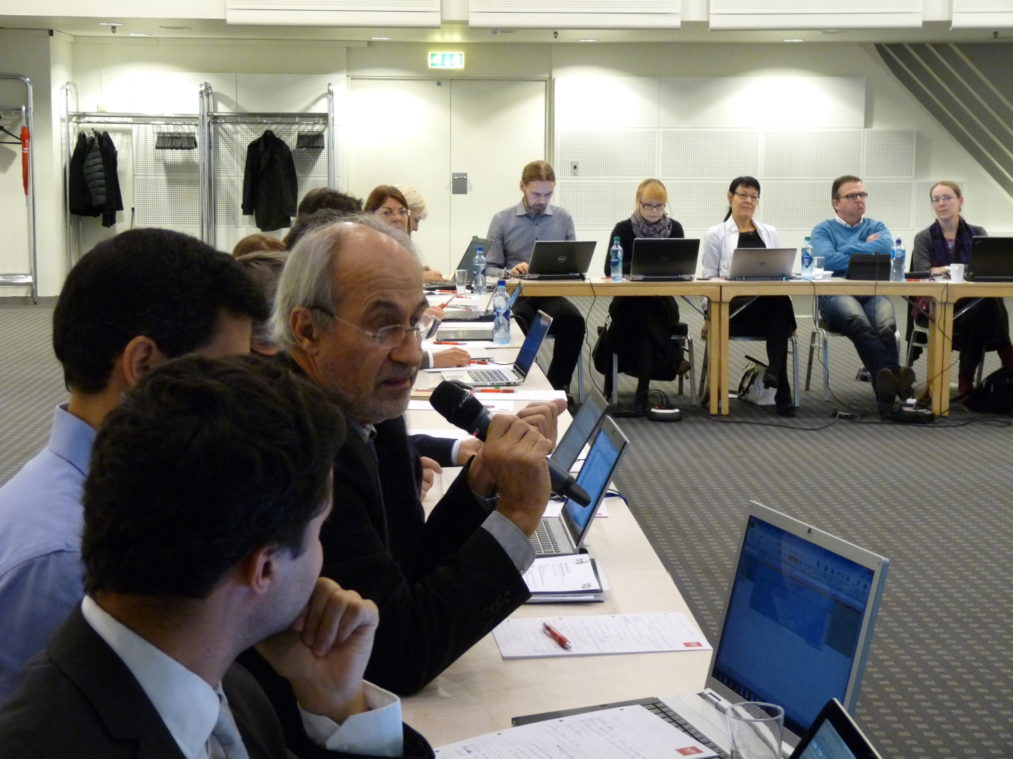
Challenges ahead:
National Programmes: Which role for JPIs?

Slide 11
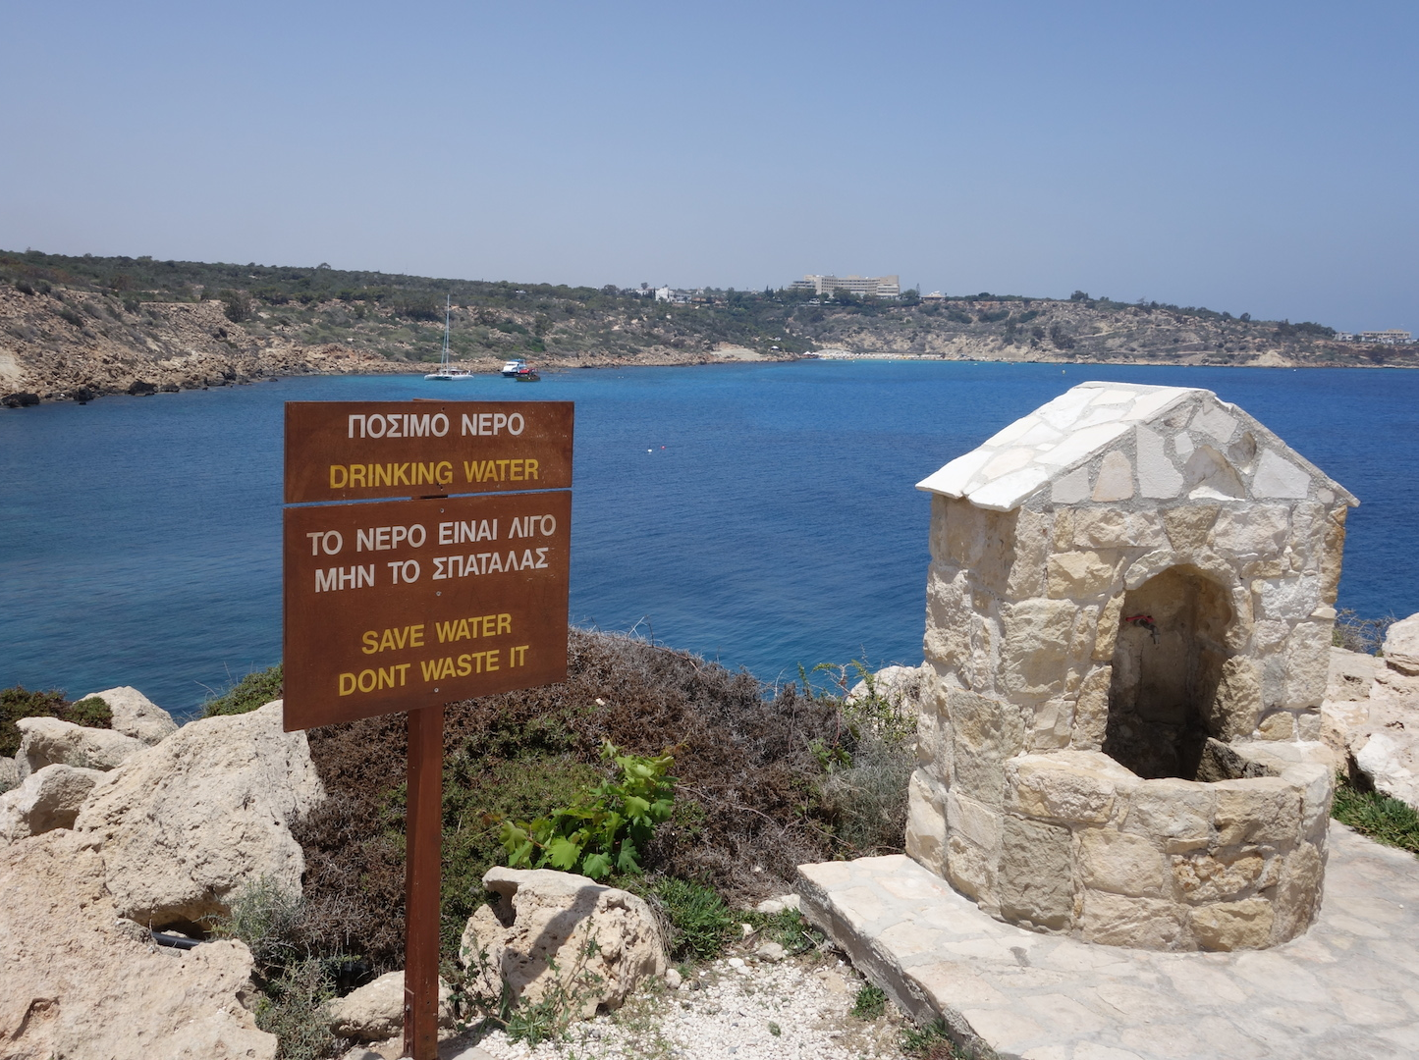
Thanks!

