Slide 1
A long term global vision
Maurice Héral
JPI WATER GB Chair

Slide 2
A constat: Water will be the first mineral ressource which will be lacking on the blue planet

Slide 3
2030 Sustainable Development Goals
What role for Science ?

Slide 4
The demographic context

Slide 6
Water for what?

Slide 7
UNEP

Slide 8
WATER STRESS INDICATOR
Ratio of withdrawals to supply

Slide 9
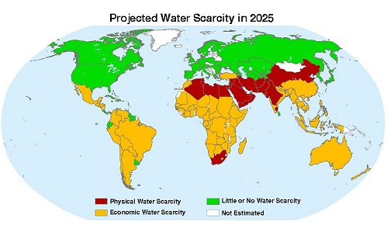
WATER SCARCITY
WATER SCARCITY

Slide 10
62% of the world population under water scarcity in 2030

Slide 11
Drough in warmer periods

Slide 12
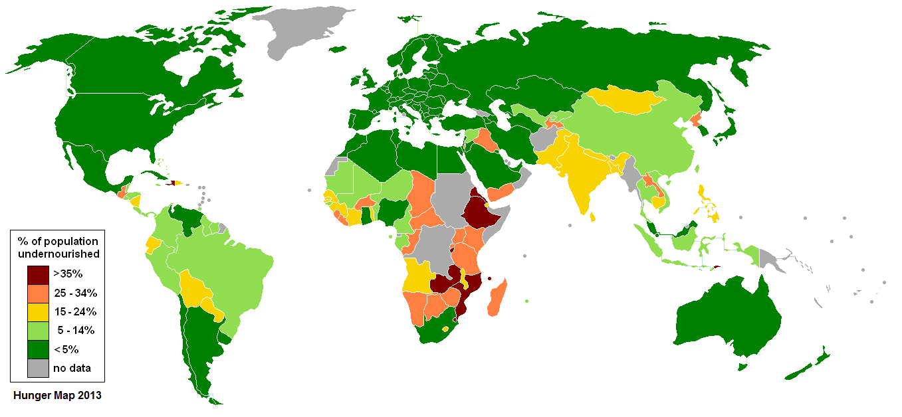
HUNGER MAP

Slide 13
Climate change evolution Ipcc

Slide 14
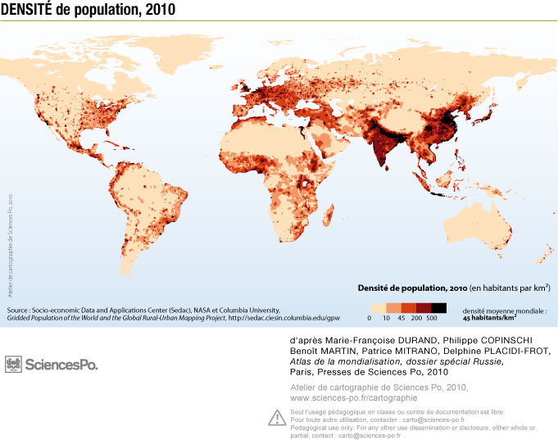

Slide 15
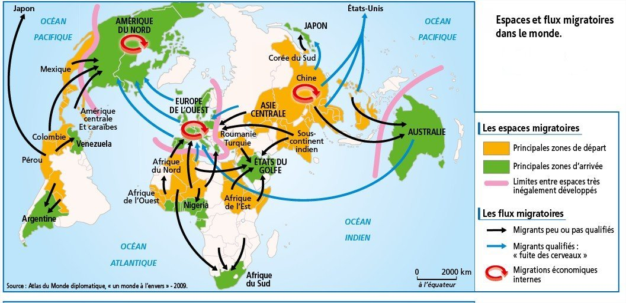
Human migration

Slide 16
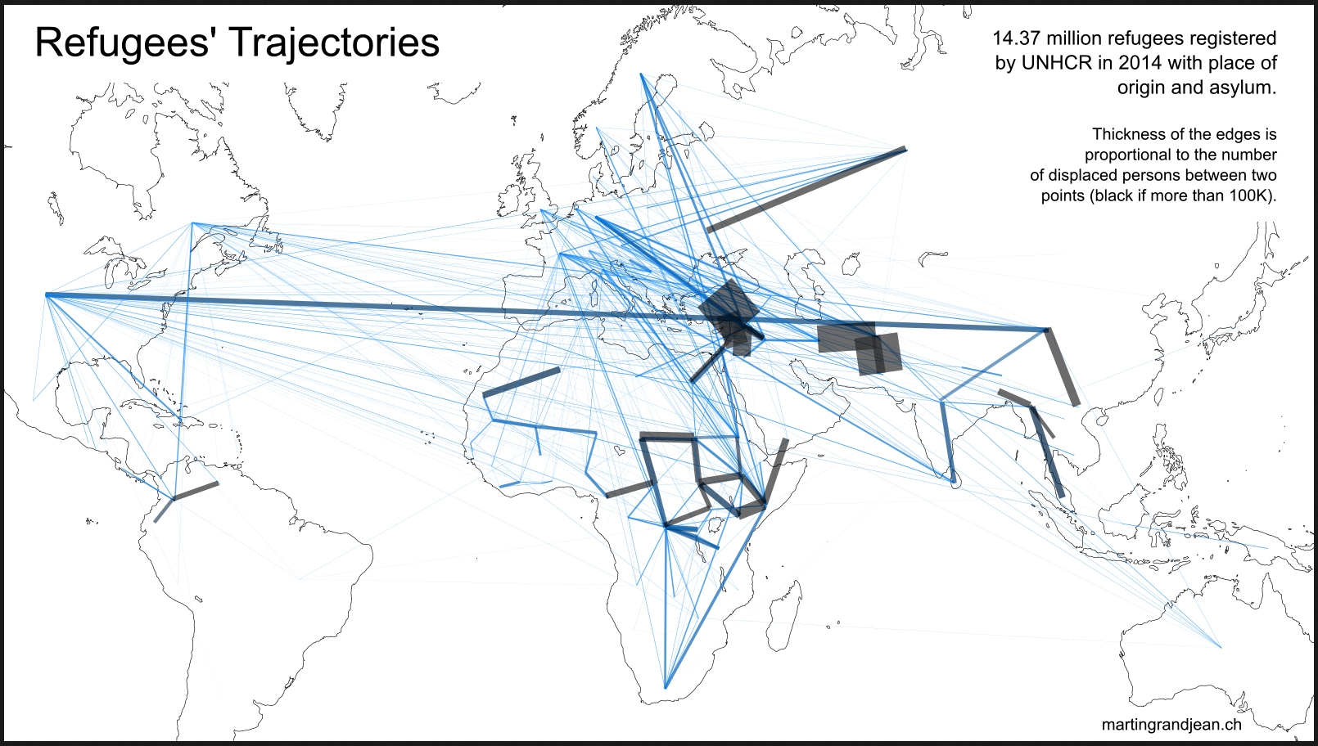
2/3 of the migrations are caused by absence of food security

Slide 17
What research can bring?
Identification of the ressources surface and underground and their sustainable levels of exploitation
Expected evolution of the ressources for medium term
Solutions to better manage the water ressources , reservoirs, distribution , leakages
Developing safe water systems by inprooving sanitation technics
Prevention and treatment of water human deseases
Creation of new ressources: recycling, wastes treatments, desalinisation, morning dew, condensation collectors…
Climate enginiering: clouds, shadow, role of forest and rain, green barier to stop desertification,
Improove agriculture less water consuming: plants adapted to drough, adapted new periodic irrigation system, ICT agri
Soil changes with increase of organic matter(4%°) for water retention and carbon sequestration
Contribute to limit climate change by promoting use of renewable energy in all the water chain
Water prices, social acceptance and governance issues
Developp international cooperation to go faster and promoting world innovation

Slide 18
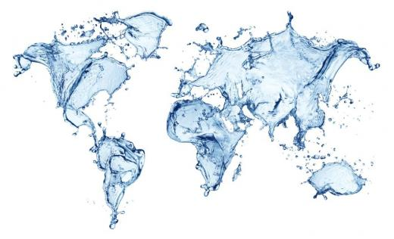
On the way: International Cooperation
RDI activities and participation of their research funding organisations in the ERA-NETs COFUND with FACCE
Brazil
Canada
USA
China
Vietnam
Taiwan
India
South Africa
Tunisia
Egypt
COOPERATION BETWEEN EU and MEDITERRANEAN, AFRICAN and ASIATIC INITIATIVES
Targeted countries: India and China

Slide 19
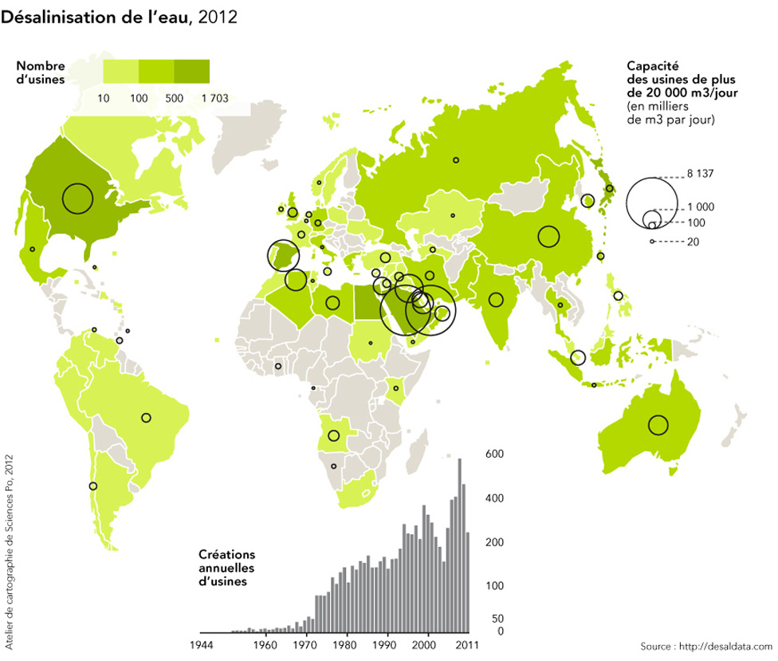
Technology improovement

Slide 20
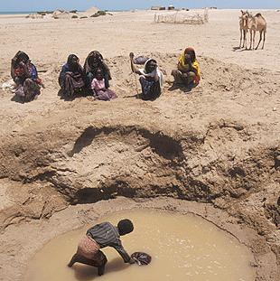
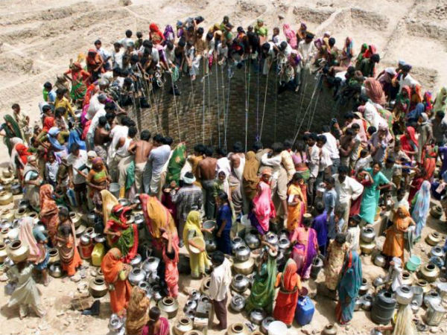
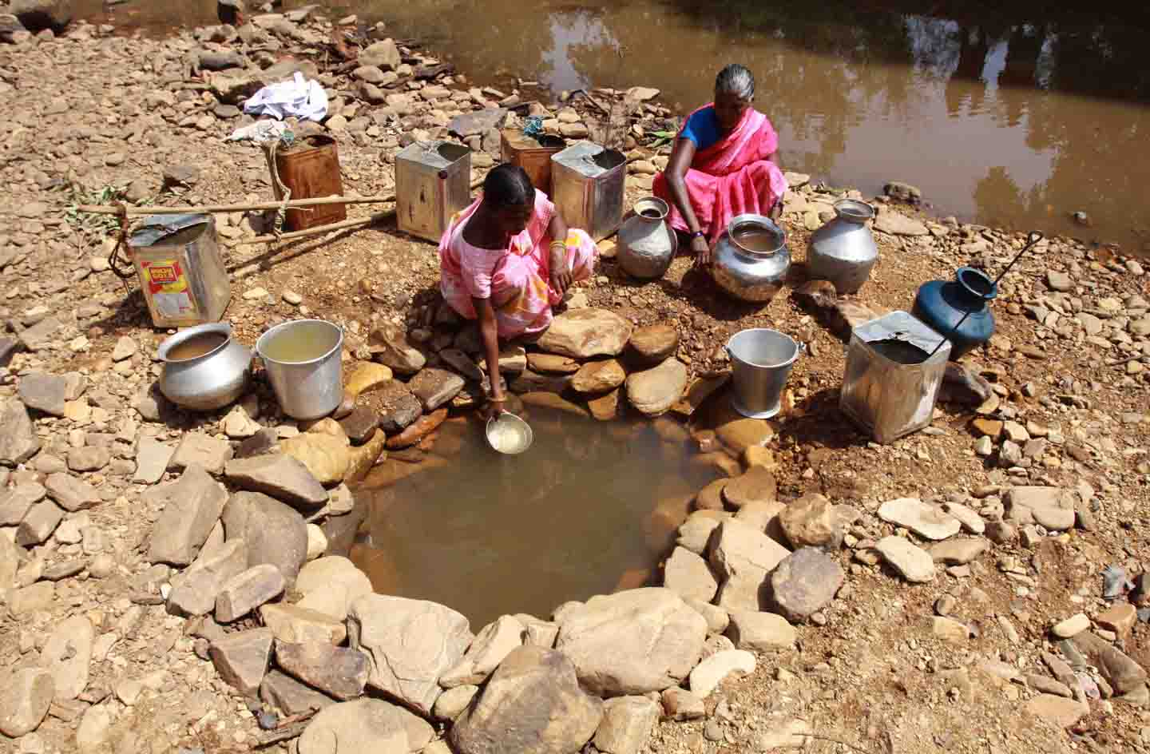
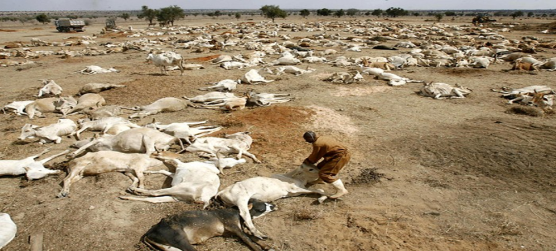
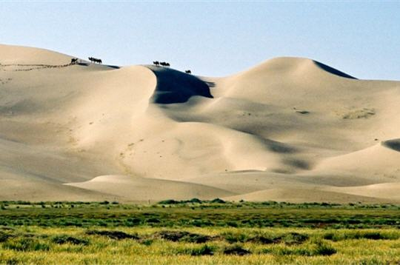

Slide 21
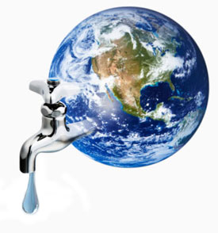
Thank you for your attention

