Slide 1
the Water JPI and International Cooperation
Dominique DARMENDRAIL,
Water JPI Coordinator
Roma
19 May 2016

Slide 2
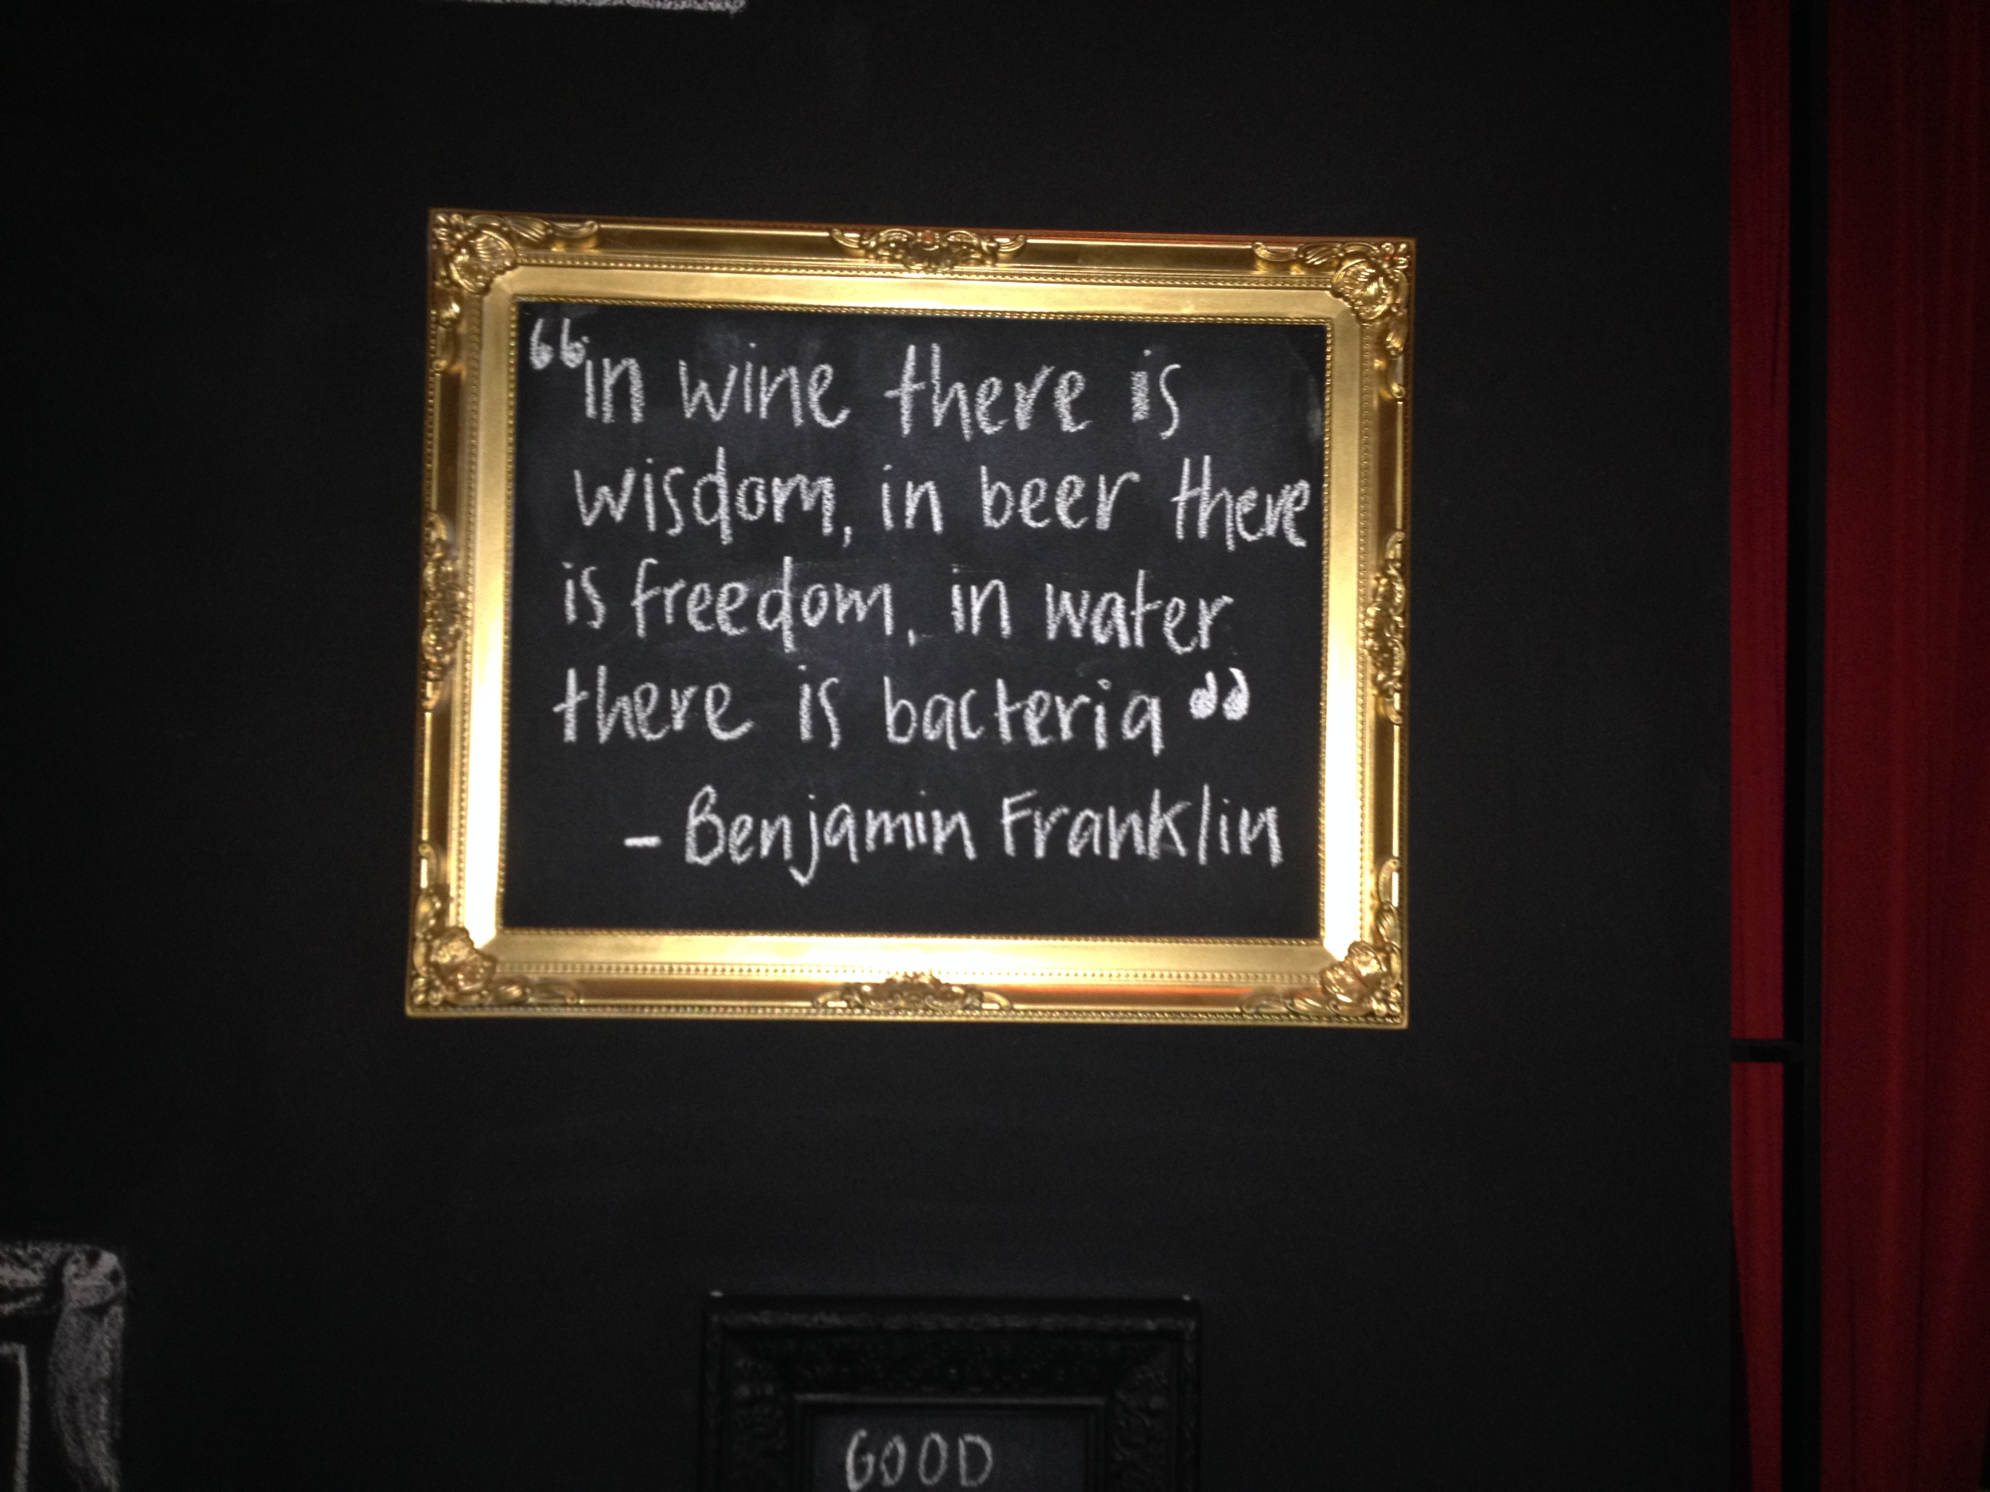

Slide 3
Main Objectives of the Water JPI and Activites to Realise
OBJECTIVES
Reaching effective, sustainable coordination of European water RDI
Involving water end-users for effective RDI results uptake
Harmonising National water RDI agendas in Partner Countries
Supporting European leadership in science and technology
TOOLS
Joint Call Management for providing and steering research and innovation in the water sector
Alignment of Research Agendas (SRIA Document and Implementation Plan) and RDI activities (including mapping activities and infrastructures)
International Cooperation (MoUs, Call Partnerships…)

Slide 4
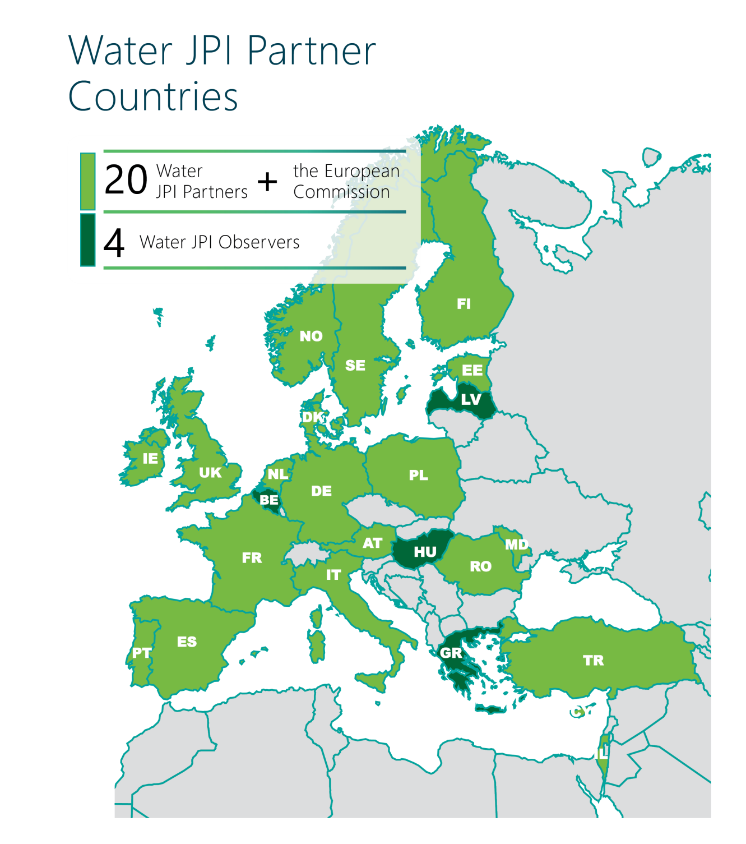
Water JPI partners currently represent 88 % of the European National Public RDI investment on water

Slide 5




Water JPI / International partners
Water JPI already has Members in several EFTA countries, enlargement countries and countries covered by the European Neighbourhood Policy
Bibliometric studies for identifying existing cooperation with:
  Other EFTA / Neighbourhood Policy countries
  Industrialised countries and emerging economies
  Developing countries

Slide 6

International Cooperation
Mapping of RDI activities and first contacts with research funding organisations to invite them to participate in the ERA-NET
  Brazil
  Canada
  China
  India
  South Africa
  USA
  Vietnam
> Criteria: Scientific excellence, development and market

Slide 7
Cooperation challenges
International Cooperation Challenges
STRENGTHS
- Common Water challenges: policy-making & RDI
- Well-established cooperation with some countries (bilateral or multilateral, networks of researcher communities)
- Access to existing knowledge, expertise and research infrastructure
THREATS
- Still quite fragmented water Research and Innovation with unsufficient information
- More bilateral cooperation vs. proving added value of multilateral cooperation
- Timing for preparation and decision on joining international multilateral activities
OPPORTUNITIES
- Solving socieltal challenges by reaching RDI critical mass and better RDI structuration
- Market opportunities for innovative technologies and methodologies
- New types of joint actions (Calls, knowledge hubs, observatories and infrastructures, mobility schemes, ...)
WEAKNESSES
- Complexity of cooperation (different existing funding models, different evaluation criteria, different funding rates, different S&T competences…)
- Greater role of end user (e.g. enterprise, community or state) in joint research and implementation

Slide 8

Our Wishes, long-term cooperation partnership agreements
On Joint Actions such as
  Shared strategic research agenda
  Joint calls
  Demonstration programmes or launch of demonstration platforms
  Access to key infrastructures, observatories
  Knowledge hub (including development of policy briefs, innovation factsheets)
  Joint events / conferences / workshops / webinars
  Brokerage events / roadshows
  Training and capacity building
  Mobility schemes (for researchers, for research programmes managers)
  Connections with leading research networks (e.g. COST Actions)

Slide 9
Joint Calls 2013-2016
Pilot Call
€8 million
WaterWorks
2014
€14 million
WaterWorks2015 (with FACCE)
€ 25.5 million*
2017?
2018?
€XX million
Emerging freshwater contami-nants
Water Treatment, Reuse, Recycling and Desalination
Topics to be defined
Water and Agricul-ture challenges.
with South Africa
  With Canada, Egypt, South Africa,
  Taiwan, and Tunisia

Slide 10
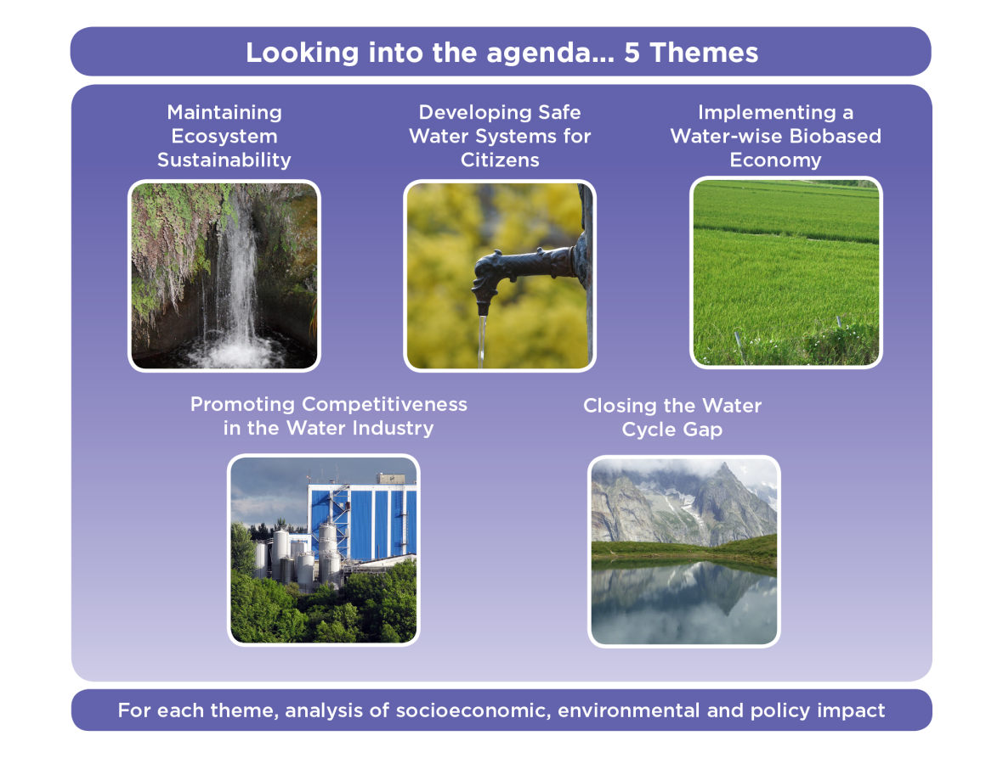
Water JPI Joint Calls in the future
IC4WATER Call – Proposed / topic in relation with UN SDGs
WaterWorks2017 – Closing the Water Cycle Gap – Sustainable management of water resources

Slide 11
A new Coordination Action – International Cooperation on Water
Implementation Activities
Strategy Activities
Strategy for enlarging Water JPI network and the dialogue platform
Knowledge hub development
Joint activities on a shared topic for the achievement of UN sustainable development goals related to water (UN SDG) – including Joint call without top-up
Building the Public – Private Partnership for developing & implementing research and innovation programme

Slide 12

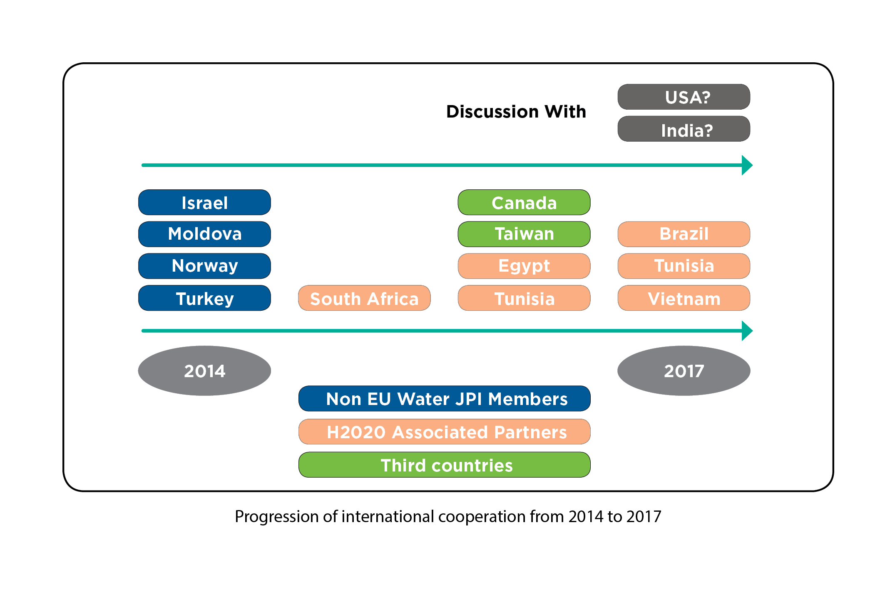
+ BONUS, PRIMA,
+ Afri-alliance, LEAP Africa, etc.

Slide 13

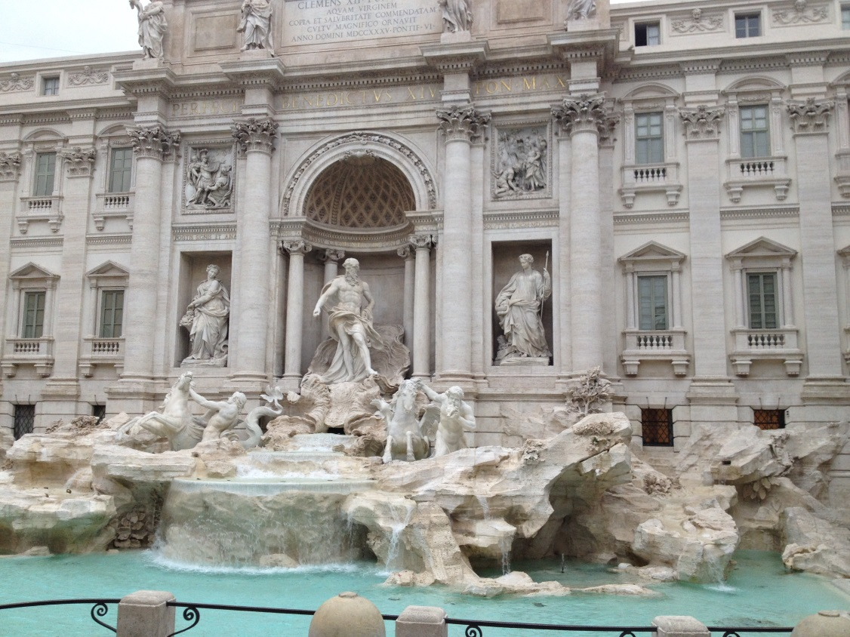
Thanks to all for your attention!
Contact
waterjpisecretariat@agencerecherche.fr
dominique.darmendrail@agencerecherche.fr
ANR

