Slide 1
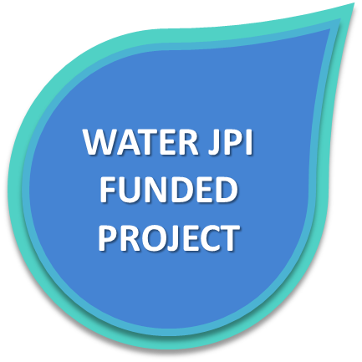
Water JPI and Emerging Pollutants
Knowledge transfer
FROM NEW KNOWLEDGE ON EMERGING POLLUTANTS IN WATER RESOURCES TO KNOWLEDGE TRANSFER
Emerging substances: substances that have been detected in the environment, but which are currently not included in routine monitoring programmes at EU level and whose fate, behaviour and (eco)toxicological effects are not well understood.
Emerging pollutants: pollutants that are currently not included in routine monitoring programmes at the European level and which may be candidates for future regulation, depending on research on their (eco)toxicity, potential health effects and public perception, and on monitoring data regarding their occurrence in the various environmental compartments.
According to the NORMAN network, at least 700 substances (categorised into 20 classes) have been identified in European aquatic environments.
KNOWLEDGE Hub on Emerging Pollutants in details
Seed group – 24 scientists involved in projects funded by the Water JPI, National Agencies or European Frameworks
Participating countries – Belgium, Cyprus, Denmark, Finland, France, Germany, Ireland, Israel, Italy, Norway, Portugal, South Africa, Spain, Sweden and United Kingdom
Start date – March 2018, for 24 months with possibility of enlargement
First expected outcomes – Policy Briefs on exposure assessment, source control, risk management, as well as new scientific partnerships for upcoming actions
Water JPI Activities in this area
Projects funded by the Water JPI address several scientific questions related to emerging pollutants in water resources: fate and transport of pollutants; impact on aquatic ecosystems and human health and prediction of evolution; water purification; control, mitigation and method for water treatment and removal, including the sustainability improvement of the existing technologies; and possible risks for the agriculture or the freshwater aquaculture sectors.
Considering the huge challenge represented by these compounds, it was decided to launch a thematic network consisting of selected research groups within a defined area of research targeted at stakeholders - so called knowledge hub - in order to increase the efficiency of the research and innovation community.
2018 Water JPI Conference
Emerging pollutants are a major issue for human health and ecosystems
A lot done on characterizing the situation, monitoring
More to do on solutions for:
reducing impacts
changing the landscape, in particular in consumption
bridging with citizens, economic sectors and policy-makers
IN THE NEAR FUTURE…
3 joint transnational calls completed in 2013, 2015, and 2016
20 funded projects addressing emerging pollutants challenges
A special issue of the open access Water Journal on “Pharmaceutic compounds, as emerging organic contaminants, and their occurrence and transport in groundwater: sources, reactions and fate" (May 2019)
Three JPIs Water, Oceans and Anti-Microbial Resistance joining efforts for developing knowledge for reduced risks posed by emerging pollutants to waterbodies and related ecosystems and food chain, and reduced risks to human health via these ecosystems
CONTAct INFORMATION
Water JPI Secretariat
50 avenue Daumesnil, 75012 Paris, France
waterjpisecretariat@agencerecherche.fr
- September 2018 -

